Slide 1
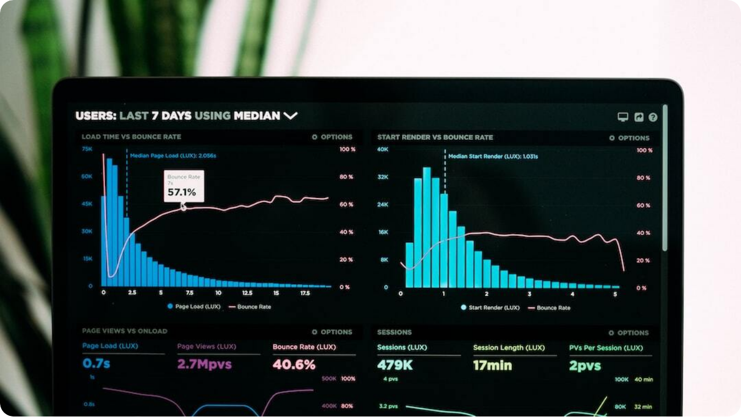
Sentiment Analysis Using Machine Learning
An overview of techniques to predict customer sentiments using ML and DL models
Presented by: Mujahid Hussain, Shahzad
Roll Numbers: 22F-3215, 22F-3228
Topic Overview: Exploring modern ML and DL approaches for analyzing customer sentiment in varied domains
Notes:
Welcome to this presentation on 'Sentiment Analysis Using Machine Learning.' In this discussion, we will explore the cutting-edge approaches for evaluating customer sentiments through machine learning and deep learning frameworks. Our goal is to provide a comprehensive overview of the techniques, their effectiveness, and practical applications in real-world settings.
The work presented here is a collaborative effort by Mujahid Hussain and Shahzad, identified by roll numbers 22F-3215 and 22F-3228 respectively. We aim to bridge the academic theories with practical implementations, especially in e-commerce, healthcare, finance, and social media domains.
As we proceed through this deck, you'll gain insights into model architectures like BERT and LSTM, comparison metrics, hybrid techniques involving metadata, and future research trajectories. Let's delve into the intersection of artificial intelligence and human emotion.

Slide 2

Abstract
Advancing Sentiment Analysis Through ML and DL
Advanced ML Models: Machine learning models can efficiently process unstructured text data at scale.
Deep Learning Superiority: BERT and similar models outperform traditional methods in capturing nuance and context.
Hybrid Efficiency: Combining approaches optimizes performance while managing computational demands.
Broad Applications: Applicable in e-commerce, finance, healthcare, and social media sentiment tracking.
Notes:
This presentation delves into how machine learning revolutionizes sentiment analysis by handling massive datasets composed of unstructured text, such as customer reviews. These models identify emotional tones, trends, and actionable feedback with much greater efficiency than traditional statistical methods.
Deep learning models like BERT have introduced a significant leap in performance. These models understand the subtle nuances of human language, including context, sarcasm, and domain-specific expressions—challenges that rule-based or bag-of-words models often struggle with.
Hybrid approaches, which blend traditional and deep learning methods, strike a balance between accuracy and computational resource usage. These techniques are already being widely applied in sectors such as e-commerce for product feedback, finance for market sentiment, and healthcare for patient emotion tracking.

Slide 3




Introduction
From Lexicon-Based to Deep Learning Sentiment Analysis
Definition
Sentiment analysis, or opinion mining, uses NLP to evaluate emotional tone in text.
Application Areas
Applied in marketing, healthcare, finance, governance, and customer experience.
Methodological Shift
Evolved from lexicon-based rules to statistical ML and advanced DL models.
DL Models
BERT and LSTM enable deeper semantic understanding, capturing context and emotion.
Notes:
To begin, sentiment analysis—often referred to as opinion mining—is the use of natural language processing to determine the emotional tone behind a body of text. It’s a key tool for understanding customer sentiment, political leanings, product feedback, and more.
Initially, sentiment analysis relied on lexicon-based approaches—essentially matching words to a predefined sentiment dictionary. However, this approach often failed in cases of sarcasm, negation, or ambiguous phrasing. The field has since shifted towards data-driven models that can learn patterns from labeled examples.
Deep learning has pushed the boundaries further. Models like BERT and LSTM can parse the context of a sentence and interpret subtle emotional cues, even when word usage varies greatly. This transformation has significantly improved the reliability and applicability of sentiment analysis across domains.

Slide 4




Research Framework for Sentiment Prediction
Structured Pipeline for Sentiment Model Deployment
Input Layer
Customer review text and metadata like verification status and review length.
Processing Layer
Text cleaning, lemmatization, and feature engineering using TF-IDF, Word2Vec, BERT.
Model Layer
ML (Naïve Bayes, SVM, Decision Tree) and DL (LSTM, BERT) model integration.
Output Layer
Classified sentiment (Positive/Negative/Neutral) with performance metrics.
Notes:
This slide presents the conceptual framework of our sentiment prediction model. It encapsulates the complete pipeline, from raw input data to final sentiment classification. At the core, this model accepts both unstructured review text and structured metadata, such as verification tags, review length, timestamps, and reviewer details.
The processing layer is tasked with preparing this input data. It involves cleaning and lemmatizing the text, followed by sophisticated feature engineering techniques. These include traditional TF-IDF and Word2Vec, as well as advanced contextual embeddings from BERT, allowing the model to grasp nuanced sentiment and emotion.
In the modeling layer, both traditional ML models and deep learning frameworks are employed and compared. Finally, the output layer categorizes sentiment into Positive, Negative, or Neutral, enriched with metrics such as Accuracy, F1-Score, and Reliability Score. This modular pipeline ensures scalability, interpretability, and robust performance across varied platforms and domains.

Slide 5
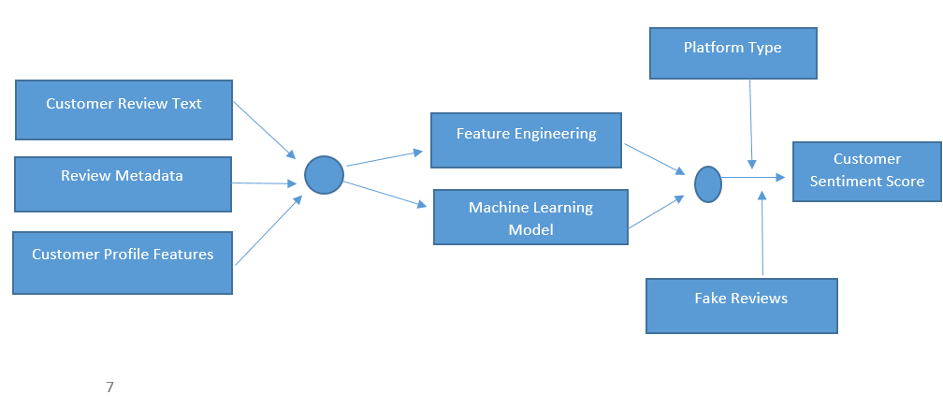

Slide 6

Research Problem & Objectives
Challenges and Research Aims in Sentiment Analysis
Core Challenge: Traditional models struggle with sarcasm, slang, and shifting domain-specific language.
Model Comparison: Evaluate and contrast SVM, LSTM, and BERT in terms of accuracy and contextual comprehension.
Feature Engineering: Investigate the impact of customized features for platform-specific sentiment patterns.
Fake Review Detection: Design methods to identify and mitigate sentiment distortion from inauthentic reviews.
Notes:
The central challenge in this study revolves around the limitations of traditional sentiment analysis models. These models often misinterpret sarcasm, colloquial language, and domain-specific expressions, resulting in reduced classification accuracy.
To address these issues, the study sets out to compare several machine learning models: Support Vector Machines (SVM), Long Short-Term Memory networks (LSTM), and Bidirectional Encoder Representations from Transformers (BERT). Each model will be evaluated for its ability to handle complex linguistic inputs across platforms like Amazon, Yelp, and Twitter.
Additionally, the research focuses on feature engineering—exploring how including metadata and context-aware features can enhance performance. Another critical aspect involves developing strategies to detect and neutralize fake reviews, which can significantly skew sentiment analysis results if left unaddressed.

Slide 7
Methodology
Experimental Setup for Sentiment Model Evaluation
Design Approach: Quantitative experimental framework to benchmark models on large datasets.
Data Sources: 30,000 labeled reviews from Amazon, Yelp, and Twitter ensure diversity and generalizability.
Model Variants: Naïve Bayes, SVM, Decision Tree, LSTM, and BERT tested for performance across platforms.
Evaluation Metrics: Accuracy, Precision, Recall, and F1-Score used for comprehensive performance analysis.
Tech Stack: Python, TensorFlow, Hugging Face, and Google Colab employed for implementation and testing.
Notes:
The methodology employed in this study adopts a robust quantitative experimental framework. The aim is to systematically evaluate various sentiment analysis models using a comprehensive and diverse dataset to ensure generalizability across platforms.
A total of 30,000 labeled reviews were sourced from Amazon, Yelp, and Twitter. These datasets represent structured, semi-structured, and unstructured environments respectively—providing a wide spectrum of textual inputs for model training and evaluation.
Five models were selected for comparison: Naïve Bayes, SVM, Decision Tree, LSTM, and BERT. Each model was assessed using standard classification metrics including Accuracy, Precision, Recall, and F1-Score. The entire workflow was executed using Python, with TensorFlow and Hugging Face handling the deep learning components, all integrated and run on Google Colab for efficient computational scalability.

Slide 8


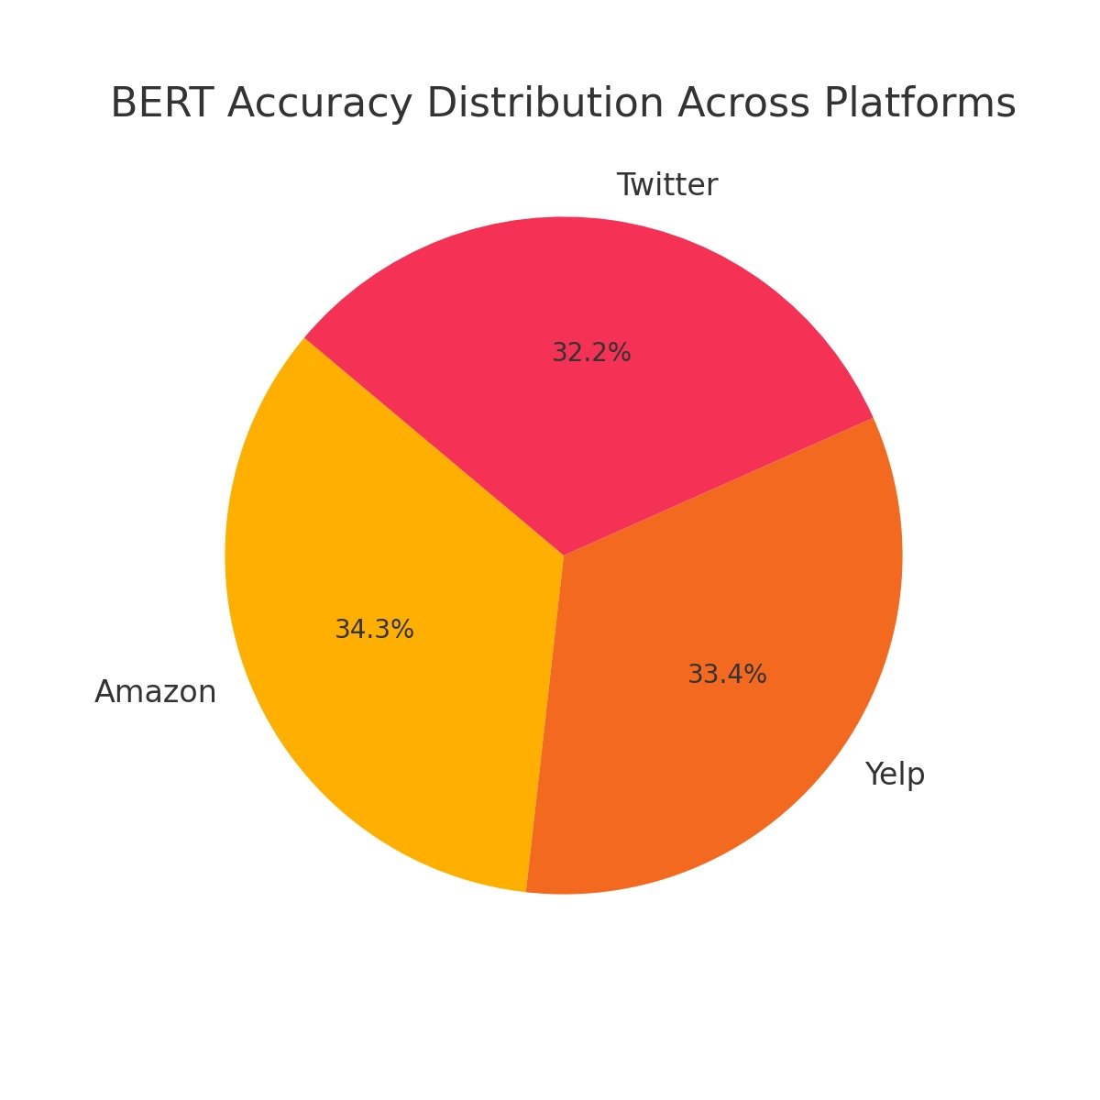
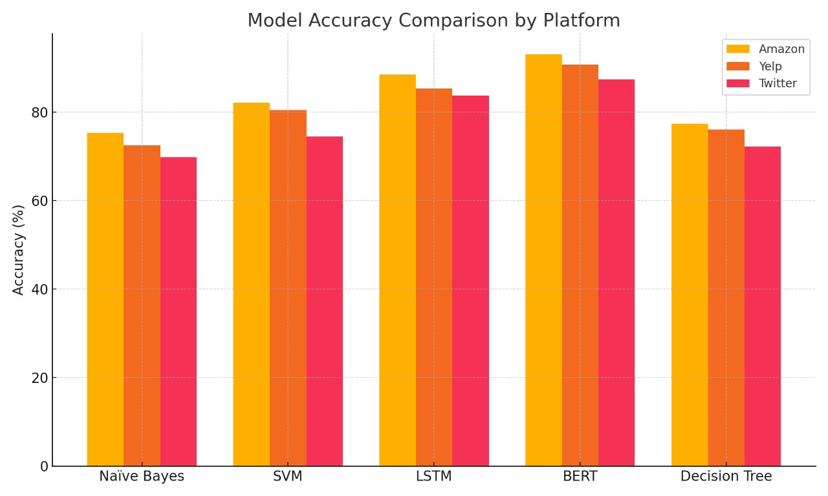
Model Performance Comparison
Accuracy of Sentiment Models on Various Platforms
BERT Leads
Top performance: 93.1% (Amazon), 90.7% (Yelp), 87.4% (Twitter).
LSTM Runner-Up
Strong performance, especially in semi-structured texts.
Notes:
Model performance varies significantly across platforms and model types. As expected, BERT clearly outperforms others in both structured and unstructured review scenarios, achieving 93.1% accuracy on Amazon, 90.7% on Yelp, and 87.4% on Twitter. These figures reflect BERT's ability to capture contextual and semantic nuances in complex language environments.
LSTM shows competitive performance, particularly where data patterns are more structured or moderately complex. However, its results still fall short of the transformer-based BERT model.
In contrast, traditional models like Naïve Bayes and Decision Trees struggle with slang, sarcasm, and abbreviated expressions common in user-generated content. Their performance drops notably in informal platforms such as Twitter. Visual summaries through bar and pie charts further illustrate these distinctions and reinforce the suitability of DL models for modern sentiment analysis tasks.

Slide 9




Feature Engineering & Fake Review Detection
Enhancing Accuracy and Authenticity in Sentiment Models
Advanced Features
Used TF-IDF, Word2Vec, and BERT embeddings to capture semantic relationships.
Metadata Integration
Incorporated features like review length and verified status to boost performance.
Fake Review Filtering
Detection techniques enhanced model reliability by 6–8%.
Aspect-Based Analysis
ABSA provided targeted insights into specific product/service attributes.
Notes:
To refine model accuracy and trustworthiness, feature engineering plays a critical role. We leveraged a multi-layered approach using TF-IDF, Word2Vec, and BERT embeddings. These techniques allowed models to understand contextual semantics and syntactic patterns far better than conventional n-gram methods.
Additionally, metadata—such as review length, reviewer history, and verification status—was incorporated into the feature space. This non-textual data proved instrumental in improving predictive accuracy, especially in identifying abnormal patterns associated with spam or fake reviews.
Fake review detection, using both linguistic and behavioral signals, was a major highlight. Our methodology improved overall model reliability by up to 8%. Complementing this, Aspect-Based Sentiment Analysis (ABSA) offered a more granular view, focusing on sentiment toward specific features or components within a product or service, delivering deeper consumer insight.

Slide 10

Results Highlights
Key Findings from Model Evaluation and Enhancement
Hybrid Model Advantage: Combining textual and metadata features yields superior accuracy.
Transformer Power: BERT effectively captures context, sarcasm, and sentiment shifts.
Platform Adaptability: Model tuning per platform is essential for peak performance.
Fake Review Impact: Filtering out inauthentic reviews significantly improves analysis quality.
Notes:
Our analysis revealed that hybrid models combining both text data and auxiliary metadata consistently outperformed text-only models. These hybrid architectures leveraged the strengths of various feature types to deliver higher sentiment prediction accuracy across all tested datasets.
Transformers like BERT were instrumental in deciphering nuanced linguistic patterns—particularly context-switches, sarcasm, and emotive expressions. Their contextual embeddings made them more robust in noisy data environments such as Twitter.
We also confirmed the necessity of platform-specific tuning. What works well on Yelp or Amazon may not directly translate to Twitter or informal chat platforms. Finally, filtering out fake reviews significantly boosted the reliability of sentiment insights, emphasizing the need for integrated trust mechanisms in sentiment systems.

Slide 11

Conclusion
Key Takeaways from Sentiment Analysis Using ML
BERT Dominance: Outperforms traditional models in accuracy and language comprehension.
Metadata Importance: Features like verified status and length crucial for precision.
Structured vs Unstructured: Platforms like Amazon/Yelp yield better results than real-time sources like Twitter.
Robust Modeling Needs: Dynamic, context-aware models essential for high-volume, real-time analysis.
Notes:
To conclude, the study affirms that modern deep learning models—particularly BERT—significantly enhance the reliability and accuracy of sentiment analysis. BERT's contextual awareness makes it a superior choice, especially for complex, high-dimensional language environments.
Equally important is the integration of metadata, which adds valuable signals for classifying sentiment more precisely. Verified reviewer tags, timestamps, and review length all help distinguish authentic from biased or manipulated content.
The findings also underscore the disparity in data complexity between structured platforms like Amazon and the chaotic, informal nature of real-time social media like Twitter. For the latter, highly adaptable models are not just beneficial—they are essential. Future efforts must continue to refine model robustness for dynamic text scenarios.

Slide 12

Future Research Directions
Advancing Sentiment Analysis through Emerging Technologies
Multilingual Models: Handle code-mixed and diverse languages for global sentiment analysis.
Explainable AI: Use SHAP, LIME to provide interpretability in decision-making processes.
Real-Time Analytics: Develop pipelines for instant sentiment tracking in dynamic environments.
Mobile & Domain Models: Lightweight models for mobile apps and domain-specific NLP (e.g., healthcare).
Notes:
Looking ahead, several key areas offer promising paths for the future of sentiment analysis. One major direction is the advancement of multilingual and code-mixed language models, enabling applications in non-English and cross-linguistic contexts.
Another crucial development lies in Explainable AI (XAI). Tools like SHAP and LIME can help demystify the black-box nature of deep learning models, making sentiment classification decisions more transparent and interpretable to stakeholders.
Equally important is the shift toward real-time sentiment analytics, especially for fast-paced environments like social media or live customer support. Efficient, low-latency pipelines are essential here. Meanwhile, lightweight models optimized for mobile platforms and industry-specific domains like finance or mental health can further democratize and personalize sentiment analytics. These innovations will expand the reach and utility of this powerful AI application.

